Slide 1
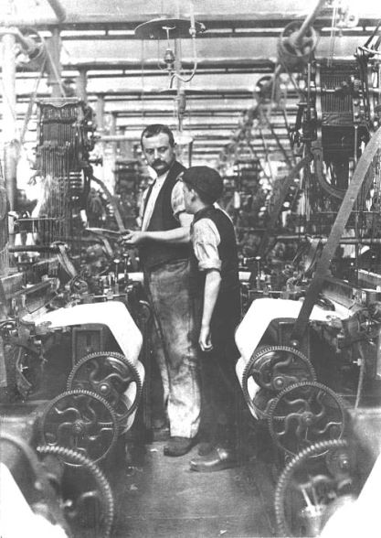
Children at work during the industrial revolution
Using sources to investigate….
A teaching resource for year 8 students
Produced by Kate Terry for www.economiespast.org
Notes:
This lesson will take about 1.5 hours to teach and is aimed at Year 8 students but adaptable for all Key Stage 3 students with editing. Internet access required along with the copying of slides 4, 9-12 and 14-17 as handouts.

Slide 2
This lesson will enable you to:
explain some of the sources available to historians from 1851 and how useful they can be
explore the kinds of work done by children where you live between 1851-1901. Was there a difference between the work done by boys and work done by girls?
identify patterns of change in the employment of children from 1851 and explain possible causes of these.
Notes:
Usefulness of sources is a common theme of GCSE – this provides students will practice in Y8
The economiespast.org website allows students to see patterns in child employment locally whereas school text books can usually only do this nationally or for prescribed areas.

Slide 3
What kinds of work did children do in your area during the Industrial Revolution?
This is a big question that will need a great deal of evidence to answer.
What kind of sources or evidence could you, as a historian, use to answer this question?
Task 1: exploring sources
What sources could you use to find out the type of work that children did in your area in 1851?
Explore possible sources on the next slide and discuss which might be the most useful and why.

Slide 4
Working with a partner, decide which of these sources would be available to you from 1851 and how useful they might be:
What sources could you use to find out
the sorts of work that children did in your area in 1851?
Possible source | Find out more.. | Available in 1851? | Useful?
Census (official count or survey of the population) | http://www.nationalarchives.gov.uk/help-with-your-research/research-guides/census-records/
Church records (e.g. parish registers of baptisms, marriages and burials) | https://parishregister.co.uk/
School registers (admission registers and log books) | http://www.schoolrecords.org.uk/
Newspapers | https://www.britishnewspaperarchive.co.uk/
Photographs | http://www.directoryphotographiccollectionsuk.org/pub/apps/resources/
Poetry | https://www.bl.uk/collection-items/a-voice-from-the-factories-a-poem-by-caroline-norton-about-19th-century-child-labour
Government reports | https://www.bl.uk/collection-items/report-on-child-labour-1842
Other?
Notes:
Hyperlinks provided if the teacher or students wish to explore the different types of sources in more detail.

Slide 5
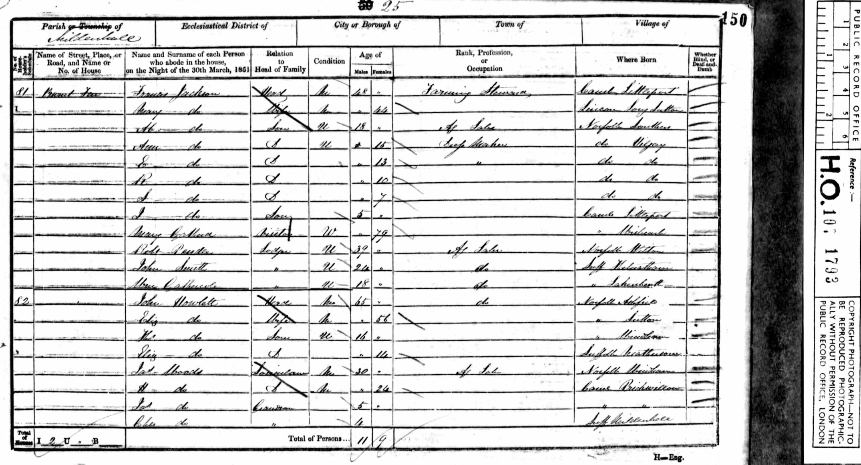
The maps that you are about to explore are based on census information, so what information can the 1851 census in England and Wales provide?

Slide 6
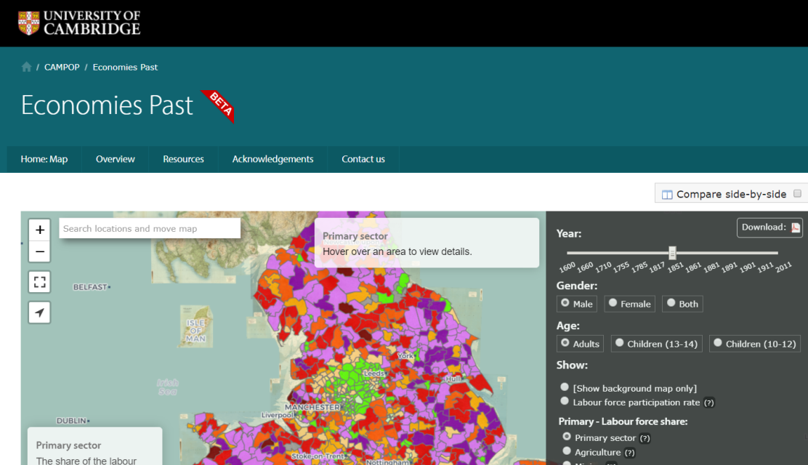
What kinds of work did children do in your area during the Industrial Revolution?
Task 2: introducing the ‘Economies Past’ website
You or your teacher log on to:
www.economiespast.org
The maps that you are about to explore are based on census information and have been developed by The Cambridge Group for the History of Population and Social Structure.

Slide 7
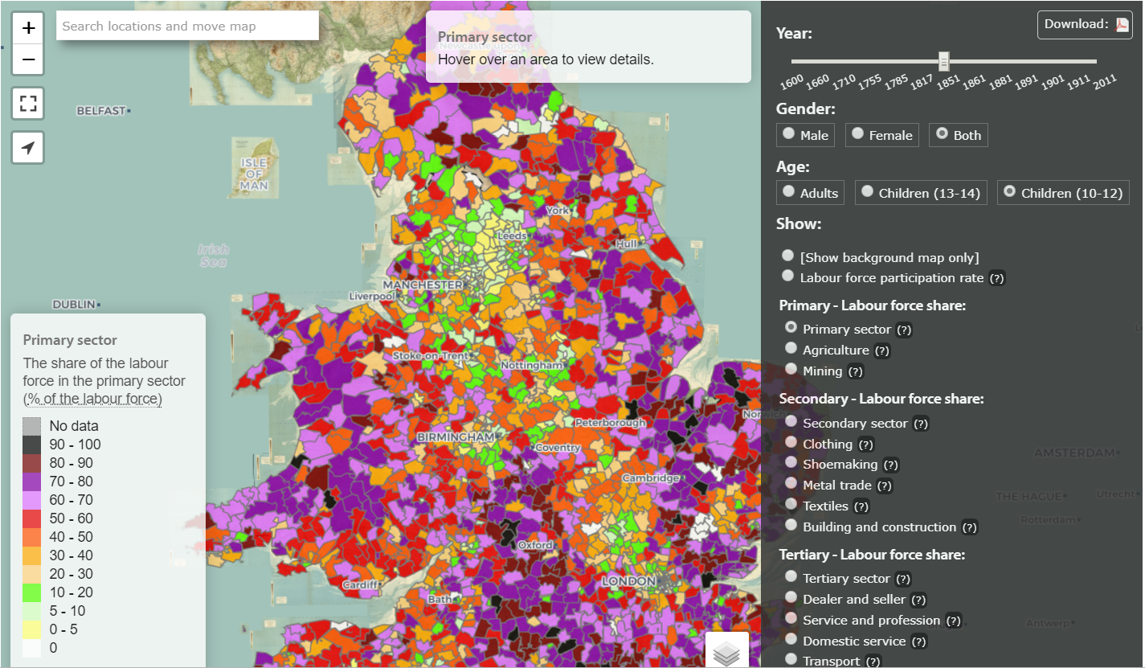
What kinds of work did children do in your area during the Industrial Revolution?
Select 1851 on the date slider.
Select ‘both’ (male and female).
Select Children (10-12)
Select ‘Primary sector’ to see those children working in agriculture and mining
Then gradually zoom into your area to take a closer look! You can hover over where you live to find out the name of your area at this time.
Notes:
Students are asked to focus on their own area for this study. This might be of more interest to them and easier for lower ability students to find on a national map. Also, in focussing on one area initially, it may help students understand data at a parish level before looking at national patterns in later studies.

Slide 8
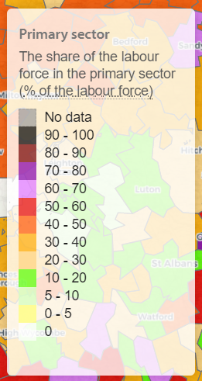
What kinds of work did children do in your area during the Industrial Revolution?
Discuss with a partner what this map is showing you. Look closely at the key.
The key shows that each colour on the map represents a range of percentages.
Sometimes no data is available for a particular date or category. If this is the case, you’ll see the area will be grey. If there is no data for your own parish, look at the parish next to it instead.
Each range in the key for your chosen map shows you the percentage (%) of children aged 10-12 as part of the total labour force (everyone who was in work whether male, female, adult or child).
It’s important to remember that what you see is the % of children in employment and not the total number or % of children in the population.

Slide 9
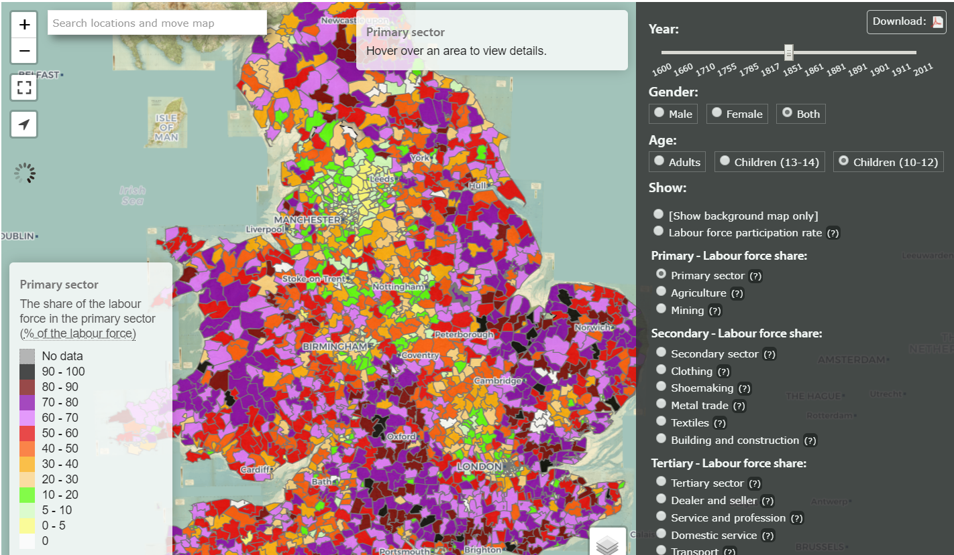
Explore the map for the area where you live. What can you see? Does anything surprise you?

Slide 10
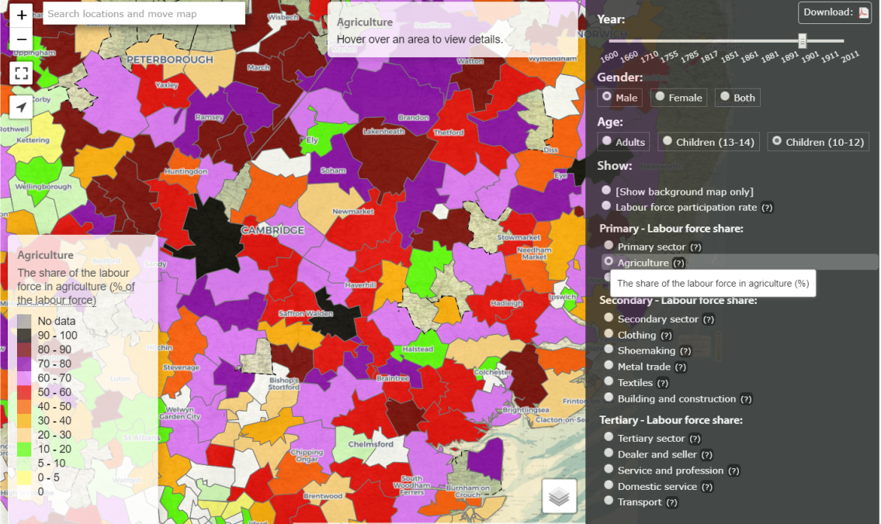
What kinds of work did children do in your area during the Industrial Revolution?
Task 3: exploring different maps
You now need to explore the maps for your area or parish in more detail to help you answer the question above.
Use the grey navigation bar on the right hand side of the screen again for 10-12 year old children in the primary sector. However, this time, explore the 1901 map and discuss any changes with a partner.
Then have a look at the same group of children (10-12 year old males and females) working in agriculture only (see button under ‘primary sector’).
Next, select only males aged 10-12 working in agriculture only in 1851. Compare this with a later map of the same labour force in 1901.
Once you feel confident about moving between the different maps, complete the table that’s the most appropriate for you on the next 3 slides.
Some help with the terms before you begin:
Domestic service: involves a person who works within the employer's household whose responsibilities may include cooking, laundry and ironing, shopping for food and other household errands.
Mining: involves mining and quarrying of coal, stone and other minerals or metals such as lead.
Textiles: involves the production of cloth rather than the making of clothes from the cloth.
Notes:
Provide students the chance to explore different maps for different years and sectors for children aged 10-12 years whether male, female or both. Make sure that they are aware of the age, year group, gender and labour sector they are viewing on each map.

Slide 11
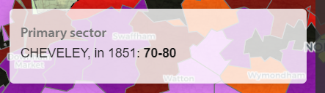
What kinds of work did children do in my area during the Industrial Revolution?
Your chosen parish (hover over your area to see the parish name):_____________________________
1851 | Primary sector |  | Secondary sector |  | Tertiary sector
Group | % of total labour force in agriculture | % of total labour force in mining | % of total labour force in textiles | % of total labour force in building & construction | % of total labour force in domestic service | % of total labour force in transport
Males aged 10-12 years
Females aged 10-12 years
1901 | Primary sector |  | Secondary sector |  | Tertiary sector
Group | % of total labour force in agriculture | % of total labour force in mining | % of total labour force in textiles | % of total labour force in building & construction | % of total labour force in domestic service | % of total labour force in transport
Males aged 10-12 years
Females aged 10-12 years
Which sector employed the most 10-12 year old children (as a % of the labour force) in your parish or area in 1851?
10-12 year old males (as a % of the labour force) were far more likely to be employed in which sector in your parish 1851?
3. What was the most significant change in the employment of 10-12 year old children in your parish between 1851 and 1901?
4. What differences can you see between 10-12 year old male and female employment (as a % of the labour force) in your parish in 1901?
5. What kinds of work are not represented by the maps you have studied?
Notes:
Handout intended for slightly higher ability Year 8 students. Notice Q5 asks them to identify what not on the maps and will therefor required more lateral thinking.

Slide 12
What kinds of work did children do in my area during the Industrial Revolution?
Your chosen parish (hover over your area to see the parish name):_____________________________
1851 | Primary sector |  | Secondary sector |  | Tertiary sector
Group | % of total labour force in agriculture | % of total labour force in mining | % of total labour force in textiles | % of total labour force in building & construction | % of total labour force in domestic service | % of total labour force in transport
Males aged 10-12 years
Females aged 10-12 years
1901 | Primary sector |  | Secondary sector |  | Tertiary sector
Group | % of total labour force in agriculture | % of total labour force in mining | % of total labour force in textiles | % of total labour force in building & construction | % of total labour force in domestic service | % of total labour force in transport
Males aged 10-12 years
Females aged 10-12 years
Which sector employed the most 10-12 year old children (as a % of the labour force) in your parish in 1851?
Which sector employed the most 10-12 year old children (as a % of the labour force) in your parish in 1901?
Most females (as a % of the labour force) worked in which sector/kind of work in your parish in 1851? By 1901, had this changed or stayed the same?
Write down 3 questions that you could ask to find out more about what you have discovered.
Notes:
Handout intended for average ability Y8 students. Notice Q4 asks students to consider possible questions for historical enquiry – a feature of many new GCSE curricula.

Slide 13
What kinds of work did children do in my area during the Industrial Revolution?
Your chosen parish (hover over your area to see the parish name):_____________________________
1851 | Primary sector | Secondary sector | Tertiary sector
Group | % of total labour force in agriculture | % of total labour force in textiles | % of total labour force in domestic service
Males aged 10-12 years | % | % | %
Females aged 10-12 years | % | % | %
1901 | Primary sector | Secondary sector | Tertiary sector
Group | % of total labour force in agriculture | % of total labour force in textiles | % of total labour force in domestic service
Males aged 10-12 years | % | % | %
Females aged 10-12 years | % | % | %
Most children aged 10-12 in the labour force in my area in 1851 worked in __________. By 1901, this was the same/had changed to _______________.
There were more boys than girls aged 10-12 employed in (agriculture/textiles/ domestic service) in 1851.
Notes:
Simpler handout providing more support for less able Y8 students

Slide 14
What kinds of work did children do in my area during the Industrial Revolution?
Task 4: using data to reach plausible/accurate conclusions
Do any of the following statements apply to your parish/area?
Question | True or false? | Evidence that might support this statement (if any)
Most children aged 10-12 in my area/parish in 1851 (as a percentage of the total labour force), were employed in the Primary Sector (agriculture and mining).
By 1901, most children aged 10-12 in my area/parish (as a percentage of the total labour force), were employed in the Secondary Sector.
There was a significant difference in the employment of 10-12 year old boys (as a percentage of the total labour force) compared to 10-12 year old girls (as a percentage of the total labour force) in my area/parish in 1901.
In my parish/area in 1851 there is evidence that there were no 10-12 year old children (as a percentage of the total labour force) working in shoemaking industry.
Can you be sure that these statements are true/false? What would you need to do to confirm that your responses are correct?
Notes:
Middle to upper ability here for Y8 students. For less able students, work as a group/whole class to agree or disagree with one of the statements above.

Slide 15
What kinds of work did children do in my area during the Industrial Revolution?
Task 5: Was the employment of 10-12 year olds in your parish or area affected by national changes?
Get into groups.
Each group will explore two of the changes or laws that took place between 1851 and 1901 as shown on the following slides.
Working together and using the maps on the www.economiespast.org, answer the questions below to help you examine whether there could be any potential impact on your parish/area of the two changes chosen by your team.
Be prepared to present your ideas and findings to the rest of the class later.
Could this change have affected 10-12 year olds?
Could this change have affected 10-12 year olds in your parish/area?
If the answer to 1 and 2 above is ‘yes’ then how might this change have affected 10-12 year olds in employment? Put forward some possible ideas in your group.
Looking at the maps that you have already studied for this age group as a % of the total labour force, can you see any possible impact of this change in any of the maps?
Notes:
A team task as this will require more lateral thinking ability and encourage counter argument. Presenting findings and ideas back to the rest of the class provides an opportunity to develop oracy and allow students to be introduced to some of the other changes not assigned to their own group. Not all the changes provided will effect child labour in your area however, by exploring the changes, students will learn some valuable contextual detail for employment in the 1800s.

Slide 16
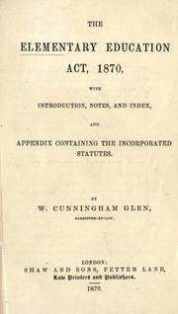
What kinds of work did children do in my area during the Industrial Revolution?
The 1870 Education Act
There were schools before 1870, but they were not available to all children in all areas.
In the 1860s, there was growing pressure for the state to provide schools in areas where none existed:
a) In 1869 the National Education League began its campaign for free, compulsory and non-religious education for all children.
b) Many people in a range of industries said that mass education was vital to Britain's ability to maintain its lead in the world.
As a result, the 1870 Education Act was passed.
The Act allowed voluntary schools to carry on unchanged, but established a system of 'school boards' to build and manage schools in areas where they were needed in England and Wales (1872 in Scotland).
Schools were not compulsory i.e. children did not have to attend.
However schools were now available for children aged 5-10 years and a fee had to be paid.

Slide 17
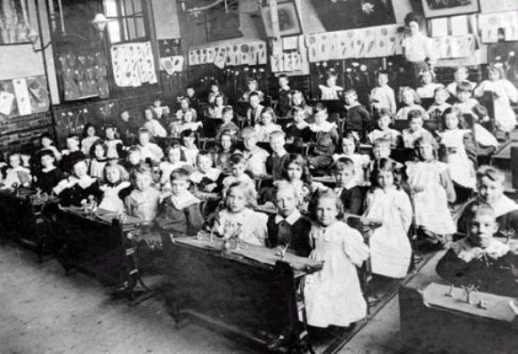
What kinds of work did children do in my area during the Industrial Revolution?
The 1880 Education Act
There were schools available for nearly all children before 1880.
These schools were not compulsory and many children did not attend (can you think why?)
The 1876 Royal Commission on the Factory Acts recommended that education be made compulsory in order to stop child labour.
In 1880, a further Education Act finally made school attendance compulsory between the ages of five and ten.
Children aged 5-10 now had to attend school by law.
School fees had to be paid until 1891 and there was a problem with attendance (at 82 per cent nationally).
Many children were in employment as well as going to school. In 1901, the figure was put at 300,000 - and truancy was a major problem due to the fact that parents could not afford to give up income earned by their children.

Slide 18
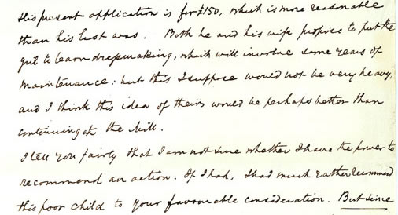
What kinds of work did children do in my area during the Industrial Revolution?
1833 Factory Act
The case of Martha Appleton in 1859 highlights the working conditions thousands of children across Britain endured every day in the 19th century.
As a 13-year-old textile worker in Wigan, Martha was employed as a 'scavenger', picking up loose cotton from beneath machinery. On one particular day, Martha fainted and caught her left hand in an unguarded machine. In the accident, all her fingers were severed. Martha lost her job because she was no longer able to work efficiently.
Changes came in 1833 when the Factory Act was passed. The Act not only created the post of factory inspector, but also made it illegal for textile factories to employ children less than 9 years of age.

Slide 19
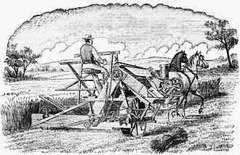
What kinds of work did children do in my area during the Industrial Revolution?
The great depression in British agriculture 1873-96
Cheap imports. By 1873, wheat could be imported from the USA cheaply because:
a) Large areas in the USA were being opened up for farming following The Homestead Act.
b) Steam-powered railways within the USA and cheap steam ships, meant that wheat could be transported cheaply and quickly to other countries such as Britain.
c) New inventions in agricultural machinery also helped American farmers e.g. the reaper binder in 1873 which helped harvesting and could double farmers’ crops.
2. The bad harvests in England of 1875, 1877, 1878 and particularly the wet summer of 1879. In the past, English farmers could drive up prices of wheat after bad harvests as there was less wheat around. However, this was no longer possible because of cheap foreign wheat imports.
The depression caused rural depopulation. There was a decline of agricultural labourers after 1871. Many of these labourers migrated to the cities in search of work and research shows an increase in urban labourers at this time.

Slide 20
How did you get on today? How confident are you about your understanding of today’s objectives?
explain some of the sources available to historians from 1851 and how useful they can be
explore the kinds of work done by children where you live between 1851-1901. Was there a difference between the work done by boys and work done by girls?
identify patterns of change in the employment of children from 1851 and explain possible causes of these.

